Slide 1
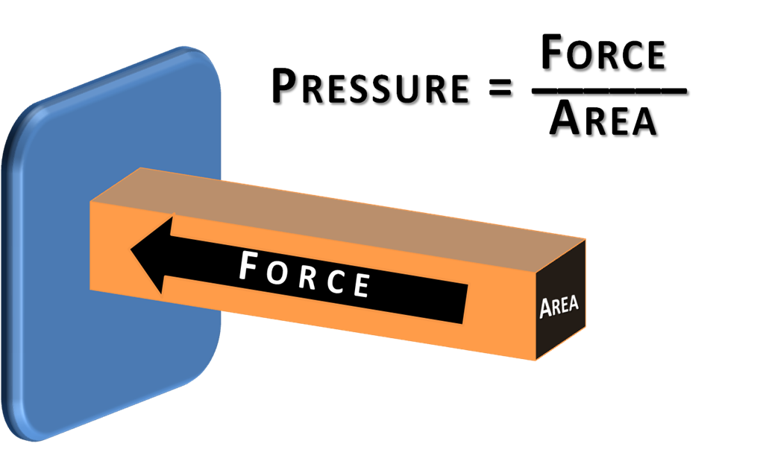
Medical physics- first year
L6
Pressure in body1
Pressure in body
By Assistants professor
Mohammed Ali Jaber
Department College of Medicine
University of Basrah

Slide 2
Objectives:
By the end of this section, you will be able to:
Explain the concept of pressure in human body.
Explain systolic and diastolic blood pressures.
Describe pressures in the eye, lungs, spinal column(skull), bladder, and skeletal system.
Pressure effects while diving
Describe Boyles and Henrys laws
The pressure in the lung
Hyperbaric oxygen therapy(HOT)

Slide 3
Pressure ( P) :is the force applied perpendicular to the surface of an object per unit area over which that force is distributed.
P=F/A
Where : F is the force ,
A is the cross sectional area
Gauge pressure ( gage pressure) is the pressure relative to the ambient pressure.

Slide 4
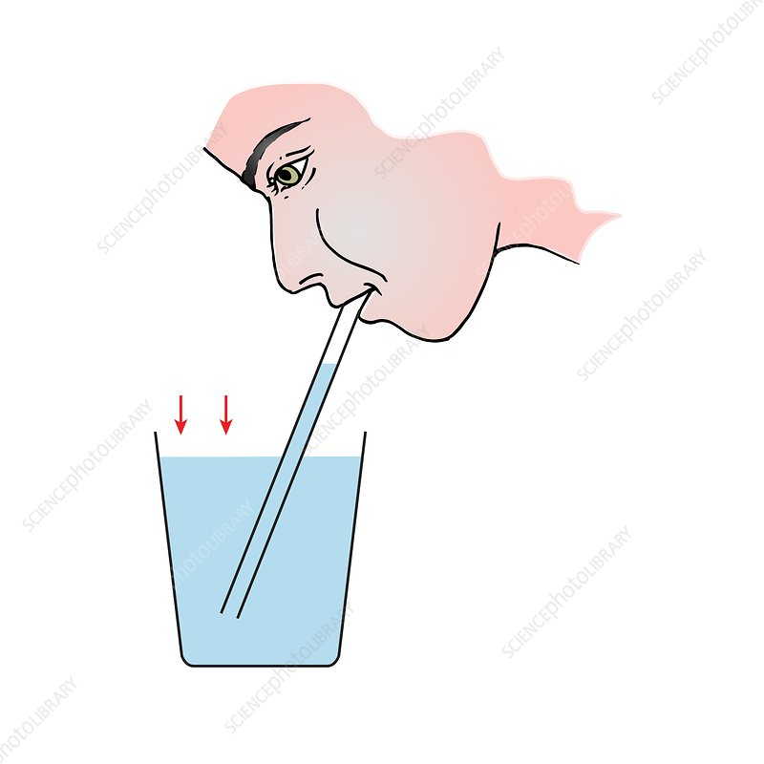
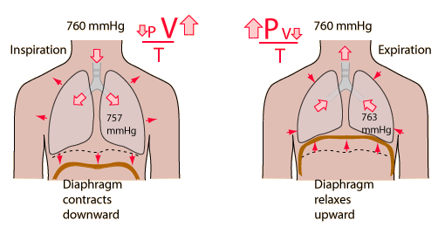
Negative Pressure
It is any pressure lower than atmospheric pressure.
The lung pressure during inspiration is a few centimeter of water negative ,
A person drink through a straw the pressure in his mouth must be negative.

Slide 5
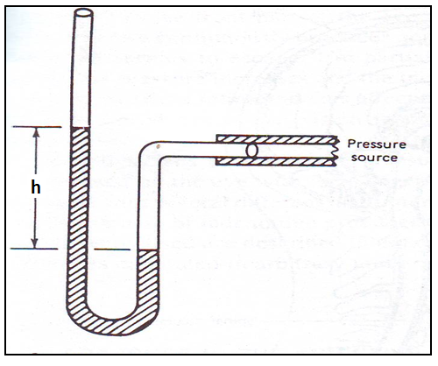
Pressure in fluid
An instrument that measures pressure is called a manometer.
The pressure P under a column of liquid can be calculated from the following law:
P= ρ g h
Where the: ρ is the density
of the liquid
g is the acceleration due
to the gravity
h is height of the column

Slide 6
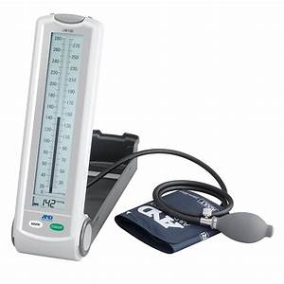
Blood Pressure
The force of circulating blood on the walls of the arteries
The common clinical instrument used in measuring blood pressure is the sphygmomanometer.
120 mm Hg systolic pressures
80 mm Hg, diastolic pressures.
The pressure differences in the circulation system are caused by:
Blood flow through the system
The position of the person.

Slide 7
For a person standing up
The pressure in the feet will be larger than at the heart due to the weight of the blood (P = hρg).
Then the increase in pressure in the feet relative to that in the heart (for a static column of blood) is given by :
ΔP=Δhρg= (1.4 m) (1050 kg/m³) (9.80 m/s²)
=1.4×10⁴ Pa
=108 mm Hg
1.4 m

Slide 9
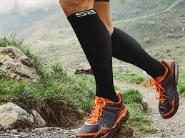
Standing a long time can lead to an accumulation of blood in the legs and swelling.
This is the reason why soldiers who are required to stand still for long periods of time have been known to faint.
Elastic bandages around the calf can help prevent this accumulation and can also help provide increased pressure to enable the veins to send blood back up to the heart.
For similar reasons, doctors recommend tight stockings for long-haul flights.

Slide 10
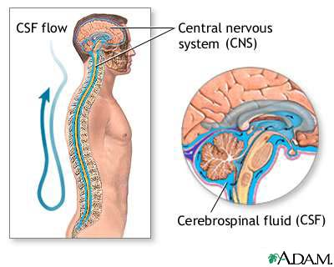
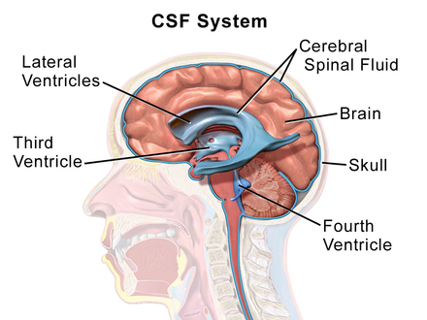
Pressure inside the skull
The brain contains approximately 150cm³ of cerebral spinal fluid (CSF) in a series of inter connected openings called ventricles
CSF (brain) ventricles spinal column circulatory system
One of the ventricles, the aqueduct is especially narrow.

Slide 11
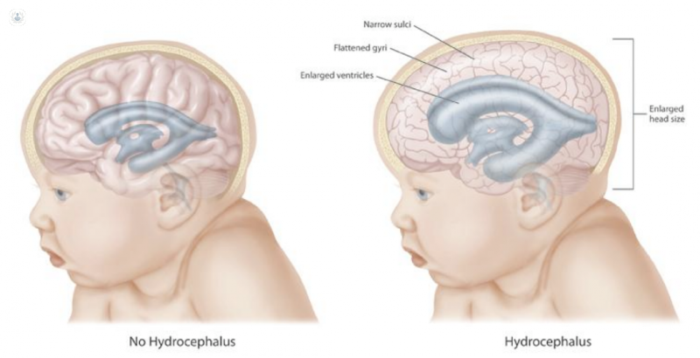
-If at birth this opening is blocked for any reason, the CSF is trapped inside the skull and increases the internal pressure.
The increased pressure causes the skull to enlarge.
This serious condition is called Hydrocephalus
Hydrocephalus is a condition in which an accumulation of cerebrospinal fluid (CSF) occurs within the brain.
This typically causes increased pressure inside the skull

Slide 12
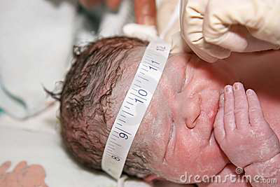
The CSF pressure, measured at lumbar puncture (LP), is 100-180 mm of H2O (8-15 mm Hg) with the patient lying on the side and 200-300 mm with the patient sitting up.
Measuring the CSF pressure
It is not convenient to measure the SCF pressure directly. There are two methods:
1- Crude method: This method can measure the pressure inside the skull by measuring the circumference of the skull just above the ears.
Normal values for newborn infants are from (32-37) cm, and a larger value may indicate hydrocephalus.

Slide 13
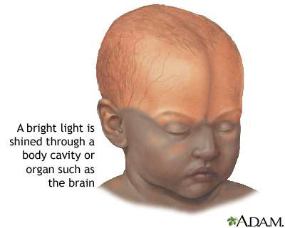
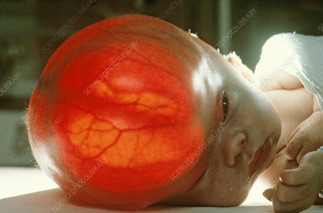
2-Transillumination: is a qualitative method of detection.
Make use of the light –scattering properties of the rather clear CSF inside the skull.

Slide 14
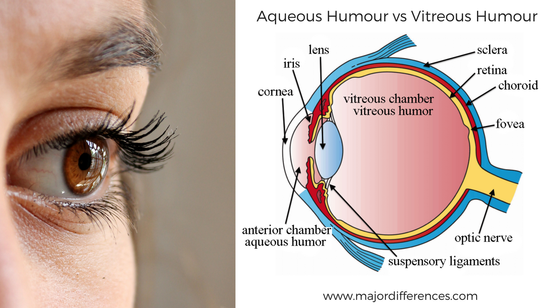
Pressure in the Eye(Intraocular pressure)(IOP)
The clear fluids in the eye ball (aqueous and vitreous humors) that transmit the light to the retina, are under pressure and maintain the eye ball in a fixed size and shape
This pressure called intraocular pressure IOP, which is normally in the range of 12.0 to 24.0 mm Hg

Slide 15
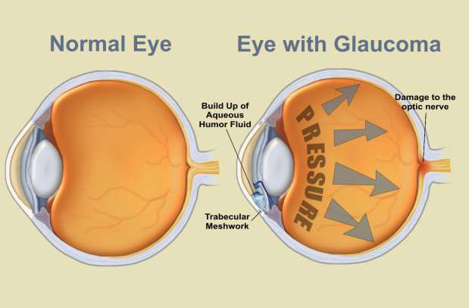
When the circulation of fluid in the eye (the drain system). It can lead to a buildup in pressure, a condition called
Glaucoma.
When the eye pressure IOP > normal ocular hypertension(no signs of glaucoma) .

Slide 16
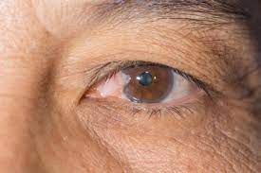
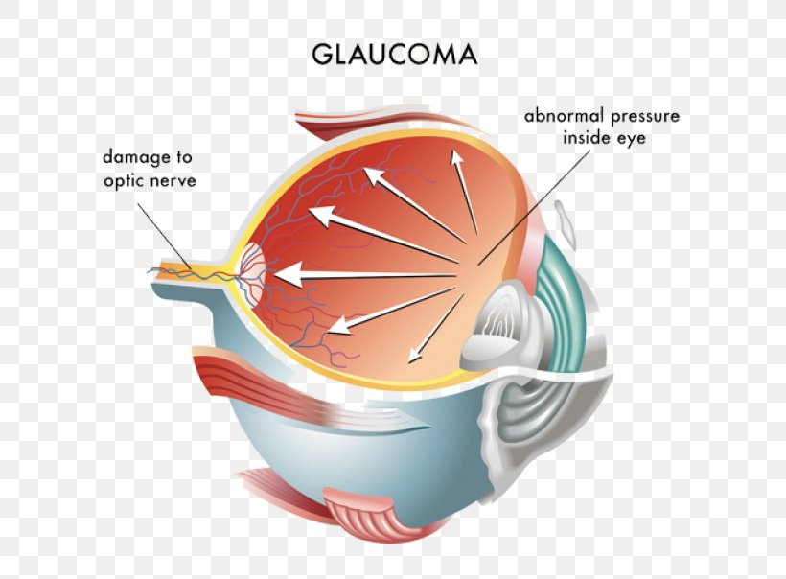
When the IOP>> normal (Elevated IOP)
The pressure increase of restrict the blood supply to the retina then affect the vision. )
This condition, called glaucoma.
Glaucoma: ( moderate -tunnel vision)
( severe -blindness)
Over 40 years of age are at greatest risk of developing glaucoma

Slide 17
If the net pressure become > 85.0 mm Hg, (damage the optic nerve).
Suppose the back of the eye has an area of 6.0 cm², and the net pressure is 85.0 mm Hg. Force is given by F = PA.
F=hρgA
=(85.0×10⁻³ m)(13.6×10³kg/m³)(9.80m/s²)(6.0×10⁻⁴m²)=6.8 N
F= m g 6.8= m* 10
m= 0.680 Kg 680 g mass
A mass of 680 g resting on the eye, would be sufficient to cause it damage
A normal force would be the weight of about 120 g (14.7 mmHg) less than 20 mm Hg

Slide 18
Measuring the eye pressure
Most measurements involve exerting a force on the (anesthetized) eye over some area (a pressure) and observing the eye’s response.
A noncontact approach uses a puff of air and a measurement is made of the force needed to indent the eye.
If the intraocular pressure is high, the eye will deform less and rebound more vigorously than normal.
Excessive intraocular pressures can be detected reliably and sometimes controlled effectively.

Slide 19
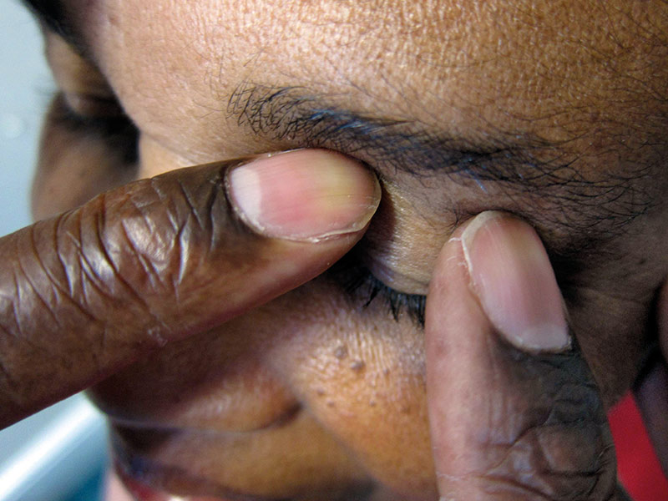
1-By feel (The fingertip test (digital palpation)):
The physicians estimate the pressure inside the eye by feel as they pressed on the eye with their fingertips.
•A normal eye should feel a bit like a tomato that is just ripe: not solid, nor very soft.
•It is important to compare the two eyes with one other. An eye with very high IOP will feel abnormally hard and solid

Slide 20
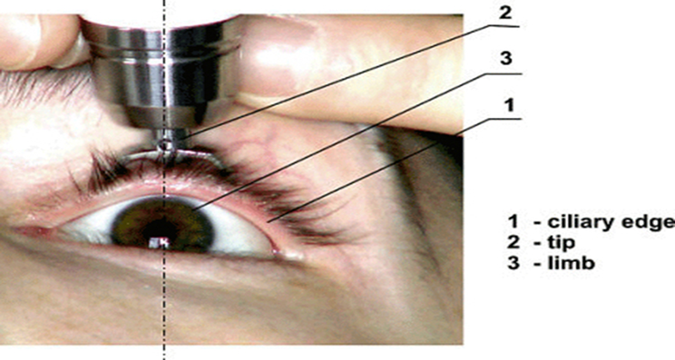
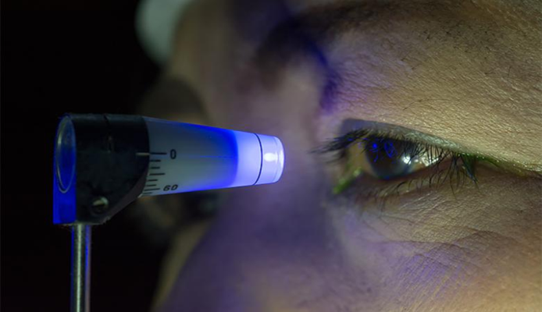
2-By the tonometer: an instrument is used to measure intraocular pressure (IOP).
Tonometry is a test to measure the pressure inside your eyes. The test is used to screen for glaucoma. It is also used to measure how well glaucoma treatment is working.

Slide 21
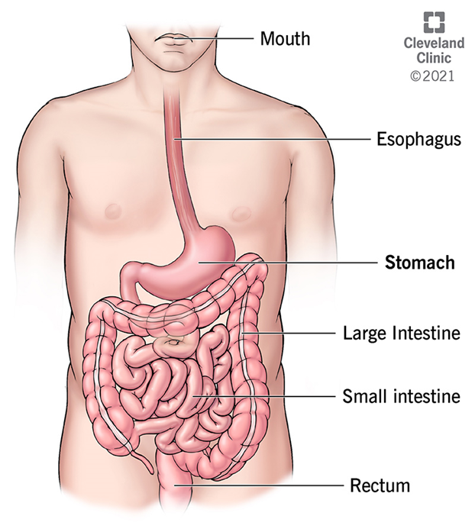
Pressure in the Digestive System
-Opening through the body
-Over 6 m
-Closed in the lower end and has several restrictions
-Valves and sphincters permit unidirectional flow of food.

Slide 22
Pressure in the gastrointestinal (GI) system greater than atmospheric pressure in most parts
Pressure caused by various muscle actions drives food and waste through the digestive system.
Stomach pressure behaves much like bladder pressure and is tied to the sensation of hunger.
Pressure in the relaxed esophagus is normally negative because pressure in the chest cavity is normally negative.

Slide 23
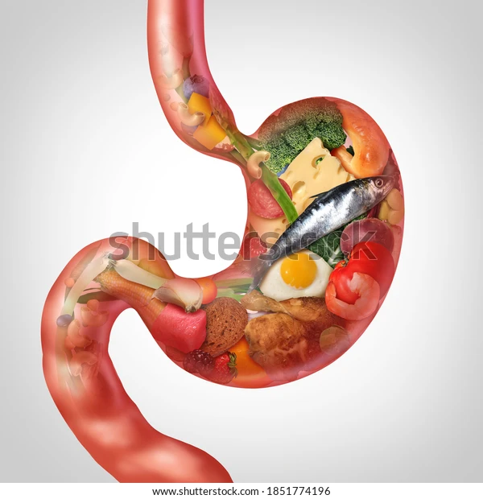
Positive pressure in the stomach may thus force acid into the esophagus, causing “heartburn.”
Esophagus pressure is usually less than atmospheric pressure
Pressure in the stomach
Eating increases the pressure in the stomach slowly due to increased volume
Air swallowed during eating increases the pressure in the stomach → burping or belching

Slide 24
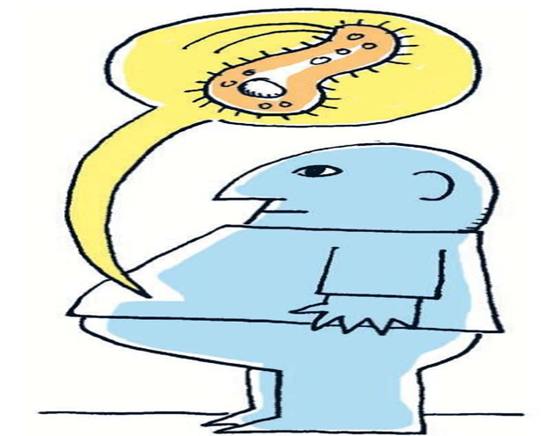
Pressure in the gut
Bacteria action generates gas (flatus) →increase gut pressure
Belts, girdles, or swimming → affect gut pressure
Pylorus : valve
Prevents the flow of food back into the stomach from the small intestine
blockage in the small or large intestine → high pressure between the blockage and the pylorus→ blockage of blood flow to critical organs → death
Treatment
Intubation: a hollow tube though the nose, stomach, and pylorus
Surgery : in a pressure controlled operating room

Slide 25
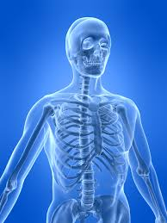
Pressures in the Skeletal System
The skeletal system works as a support structure for your body.
It gives the body its shape,
Allows movement,
Makes blood cells,
Provides protection for organs and stores minerals
The highest pressures in the body are found in the weight bearing bone (joints).
P(largest in the body)because of F(high values) and small areas , such as in the joints
It is may be more than 10 atm in the knee joint.

Slide 26
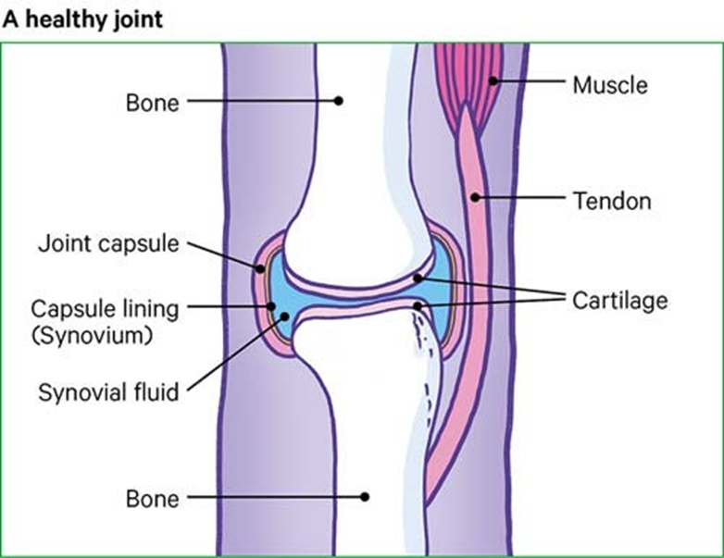
The surface area of a bone at the joint is greater than its area either above or below the joint.
The larger area at the joint distributes the force, thus reducing the pressure, according to equation P= F/A

Slide 27
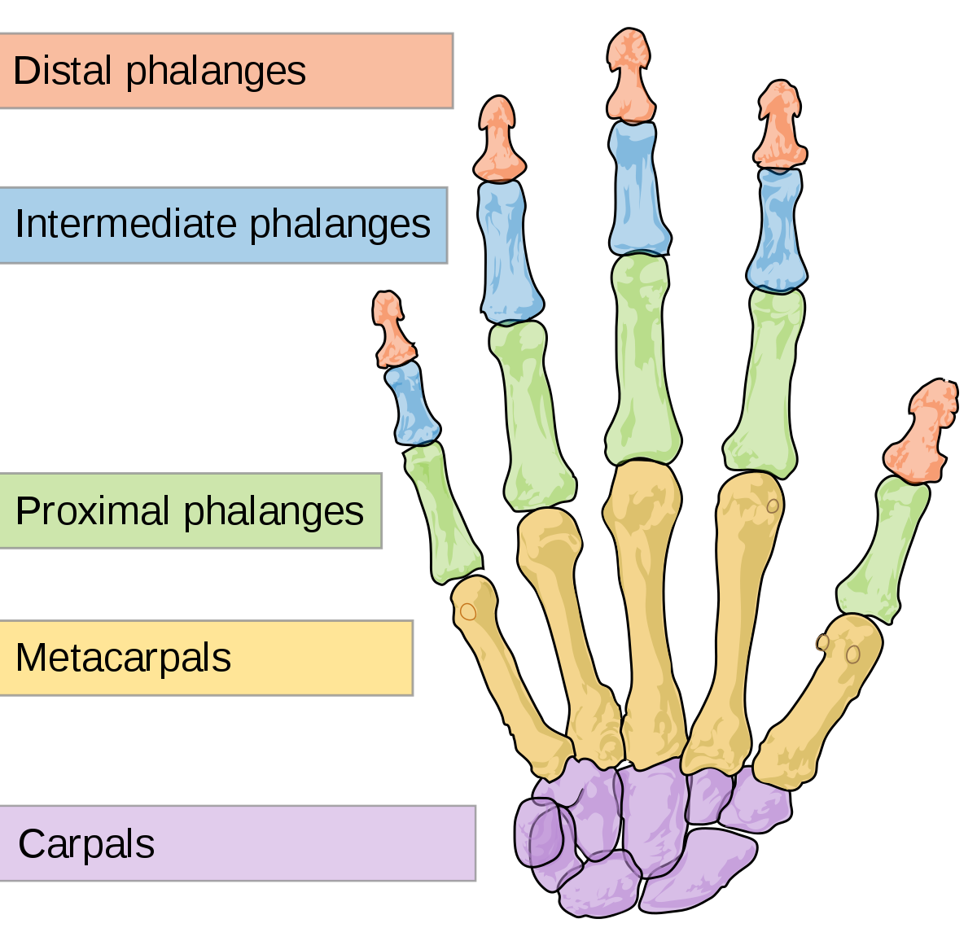
Bone has adapted in another way to reduce pressure, the finger bones are flat rather than cylindrical on the gripping side , and the force is spread over a larger surface , this reduces the pressure in the tissues over the bone according to P=F/A.

Slide 28
For example:
When a person lifts an object improperly, a force of 5000 N may be created between vertebrae in the spine, and this may be applied to an area as small as 10 cm².
The pressure created is
P = F/A = (5000 N)/(10⁻³m²) = 5.0 × 10⁶ N/m² or about 50 atm!
This pressure can damage both the spinal discs (the cartilage between vertebrae), as well as the bony vertebrae themselves.

Slide 29
Thank you

